Slide 1


Customer Churn Analysis Project
Understanding and Predicting Customer Churn

Slide 2
Team members:
Mohammed Mahmoud Mohammed Fouad (QAL1_AIS4_G1e) - 0905
Under the supervision of:
Eng. Mohammed Safi

Slide 3
Introduction

Slide 4
Introduction
Customer churn is a major challenge for businesses, referring to the rate at which customers stop using a product or service. Churn can result from dissatisfaction, better alternatives, or a reduced need for the service, making it crucial for businesses to understand why customers leave. Acquiring new customers is far more costly than retaining existing ones, so preventing churn is vital for profitability and growth.
This project aims to use data analysis and machine learning to understand customer behavior and identify the factors that lead to churn. By predicting which customers are at risk of leaving, businesses can take proactive steps to retain them, improving customer satisfaction and reducing churn rates.
Ultimately, this approach helps businesses boost customer loyalty and maximize
lifetime value.

Slide 5
Project Objective

Slide 6
Project objective
The primary objective of this project is to analyse customer behavior and predict the likelihood of churn using advanced data science techniques. By understanding the key factors that drive customer churn, the project aims to:
Identify High-Risk Customers: Predict which customers are most likely to leave, based on historical data and behavioral patterns.
Provide Actionable Insights: Uncover trends and factors, such as customer demographics, usage patterns, and interactions, that significantly contribute to churn.

Slide 7
Table of contents
Data collection and
Machine Learning Model
01
Exploration
03
Development
Understanding the role of data in
Advancing knowledge through
shaping insights.
algorithm development.
Methods of gathering and exploring
Key techniques and strategies for
data for meaningful patterns.
model building.
Data Analysis and
02
visualization
04
MLOps and Deployment
Extracting actionable insights from
Integrating machine learning into
data.
production environments.
Visualizing trends and validating
Testing capabilities and deploying
findings for better decision-making.
scalable models.

Slide 8
01
Data collection and Exploration

Slide 9
Dataset Overview
Dataset Source : Generation from python code
Key Attributes :
CustomerID: Unique identifier for each customer.
Demographics:
Age: The age of the customer.
Gender: Male or Female.
Account Information:
Tenure: Duration (in months) the customer has been with the company.
Subscription Type: Type of subscription plan chosen by the customer.
Contract Length: Duration of the customer’s contract (monthly, yearly, etc.).
Usage Behavior:
Usage Frequency: How often the customer uses the service.
Support Calls: Number of customer support calls made by the customer.
Payment Delay: Instances of late payments.
Last Interaction: The most recent interaction the customer had with the company,
Financial Metrics:
Total Spend: Total amount spent by the customer over their tenure.
Churn Indicator:
Churn: Binary variable indicating whether the customer has left (1) or remained (0).

Slide 10

Steps Involved:
Data Loading and Merging:
-Multiple CSV files were loaded, concatenated and saved into a single dataset like training and testing sets .
Data Cleaning:
-Handled missing values to ensure data integrity.
-Converted columns such as 'Age' and 'Churn' to integer type.
Feature Engineering:
-Replaced non-finite values for compatibility.

Slide 11
(500000 , 12)
500000
The dimensions of a DataFrame

Slide 12
02
Data Analysis and visualization

Slide 13


Data Tools:
-Python Libraries:
Matplotlib: Static visualizations Seaborn: Statistical visualizations Pandas: Data manipulation and analysis

Slide 14
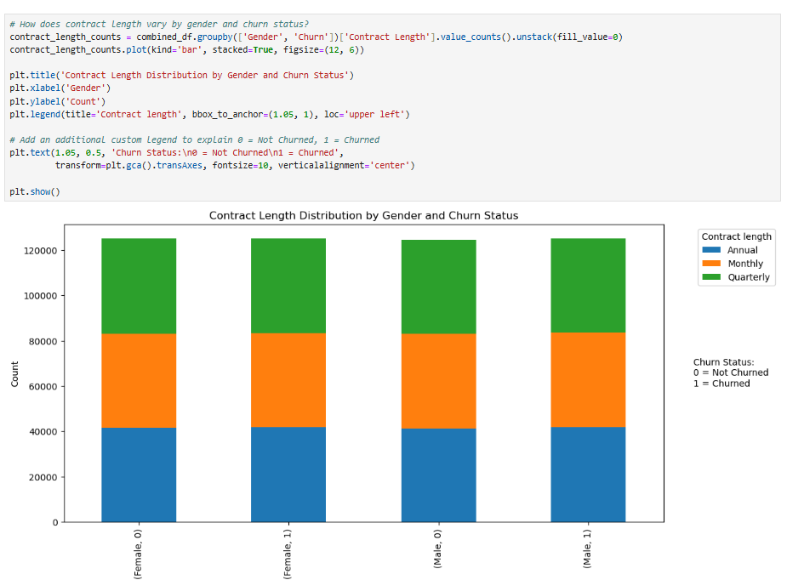
Contract Length Distribution by Gender and Churn Status

Slide 15
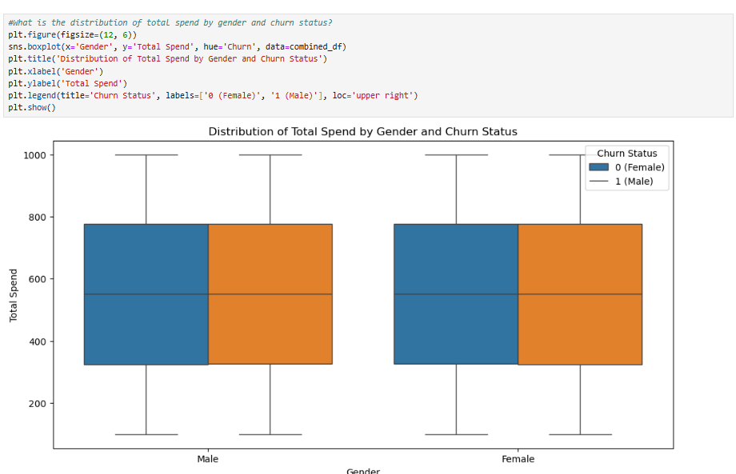
Distribution of Total Spend by Gender and Churn
Status
Both male and female customers who did not churn tend to have higher total spend compared to those who churned .Additionally, non-churning females generally spend more than non-churning males.

Slide 16
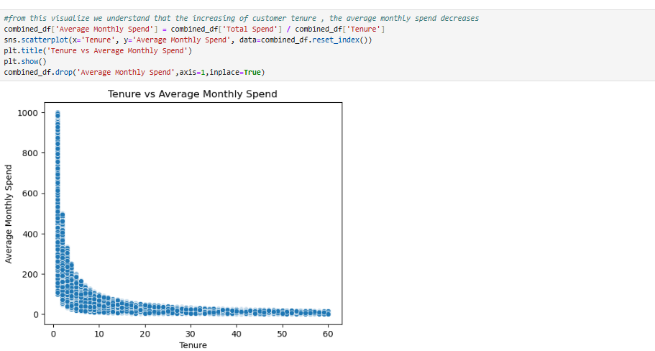
Tenure vs Average Monthly Spend
This scatter plot shows a strong inverse relationship between customer tenure and average monthly spending. Customers with shorter tenures tend to spend significantly more, but as tenure increases, their average spending drops rapidly and then stabilizes at lower values over time. .

Slide 17
03
Machine Learning Model Development

Slide 18
Key Algorithms Considered:
Gradient Boosting Classifier (GBC): A powerful ensemble model
that builds multiple decision trees sequentially to improve prediction
accuracy.
● Light Gradient Boosting Machine (LightGBM): A highly efficient
gradient-boosting model designed for fast and accurate training,
especially for large datasets.
● AdaBoost Classifier: An adaptive boosting algorithm that combines
multiple weak classifiers to create a strong predictive model.

Slide 19
Evaluating Model Performance
Gradient Boosting Classifier (GBC):
. Accuracy : 0.4931
. Precision : 0.524
. Recall : 0.51
. F1-Score : 0.51
.ROC-AUC : 0.50
Light Gradient Boosting Machine (LightGBM) :
. Accuracy : 0.936
. Precision : 0.940
. Recall : 0.946
. F1-Score : 0.943
.ROC-AUC : 0.992
AdaBoost Classifier:
. Accuracy : 0.931
. Precision : 0.925
. Recall : 0.953
. F1-Score : 0.939
.ROC-AUC : 0.989

Slide 20
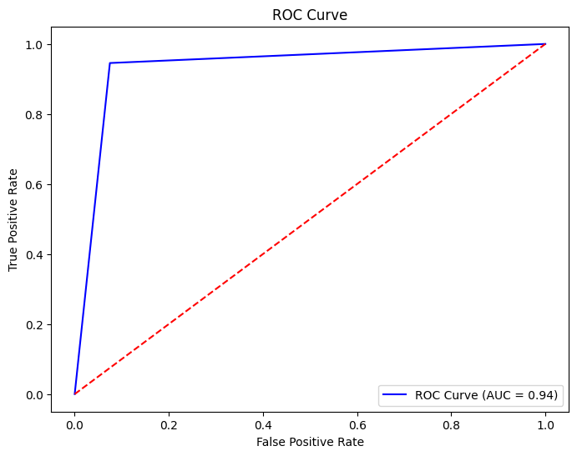
Confusion matrix and ROC curve can be used to visually assess the
effectiveness of the model and choose the optimal threshold.

Slide 21
4
MLflow and Dashboard

Slide 22
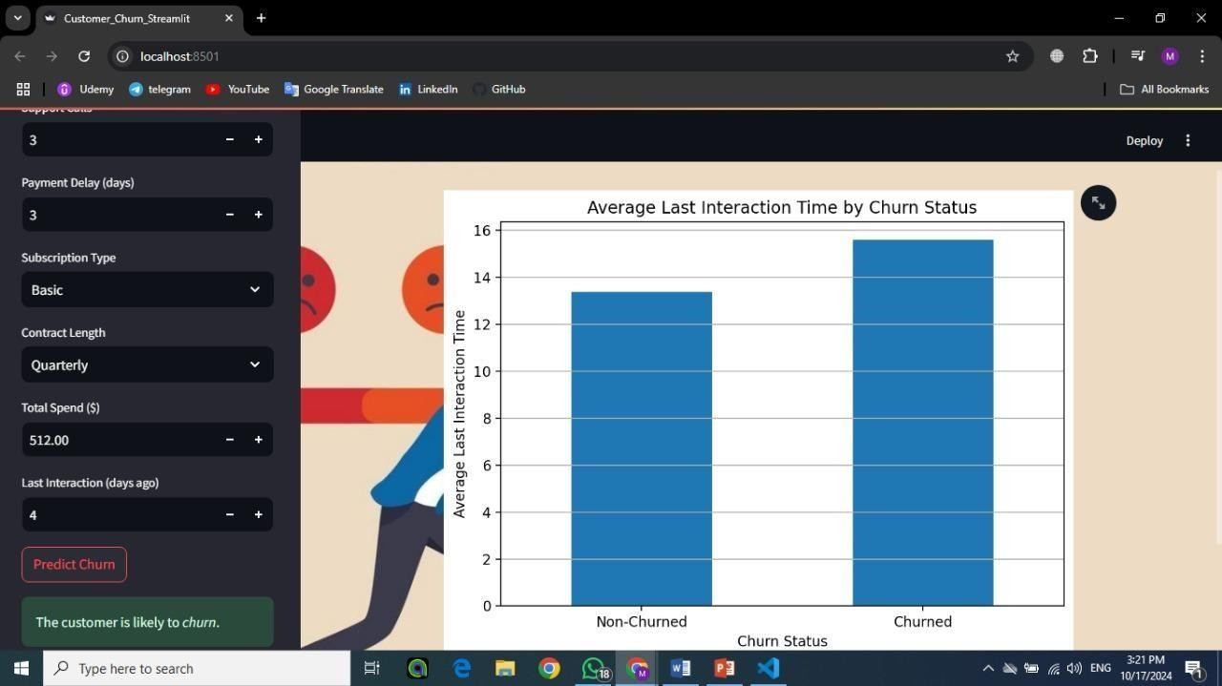
Streamlit
Interactive Dashboard: Provides an easy-to-use interface for visualizing customer churn data.
Various Visualizations: Includes charts such as pie charts, scatter plots, and heatmaps to
explore relationships between variables.
Churn Prediction: Enables users to input customer data and predict whether they are likely to churn.

Slide 23
Mlflow
Experiment tracking: Capturing hyperparameters, performance metrics, and other key details to ensure reproducibility and comparison across experiments.
Model logging and registration: Storing the final model version and registering it for
seamless access and future deployment.
This ensures the model is versioned, monitored, and continuously improved as new data becomes available, facilitating efficient updates and maintaining optimal performance over
time.

Slide 24
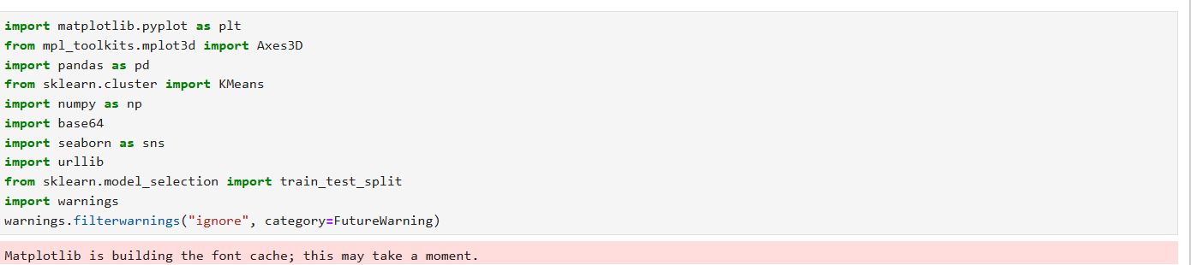

Slide 25
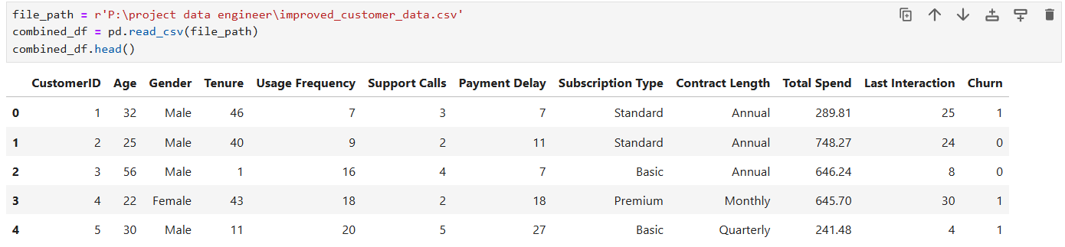

Slide 26
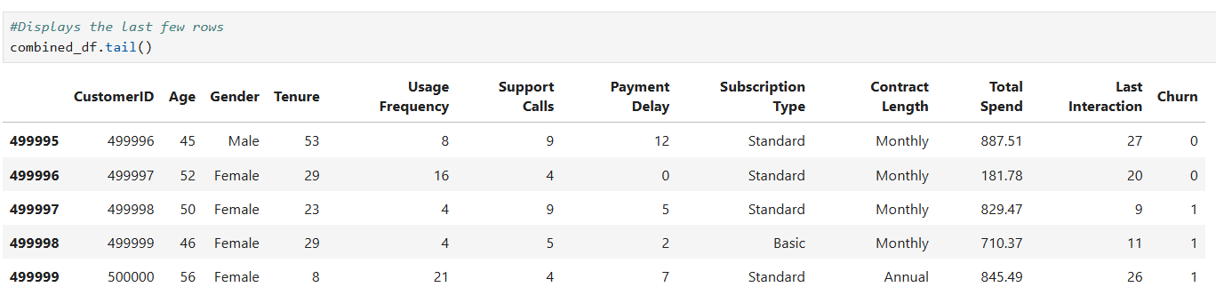

Slide 27
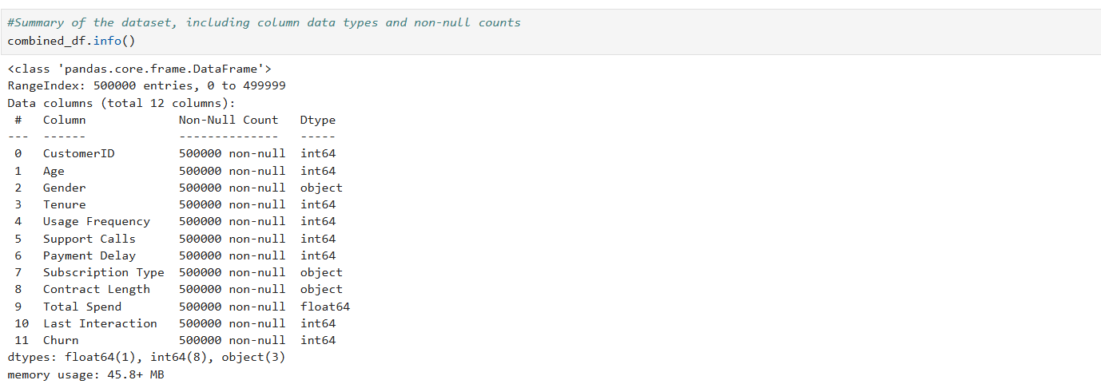

Slide 28
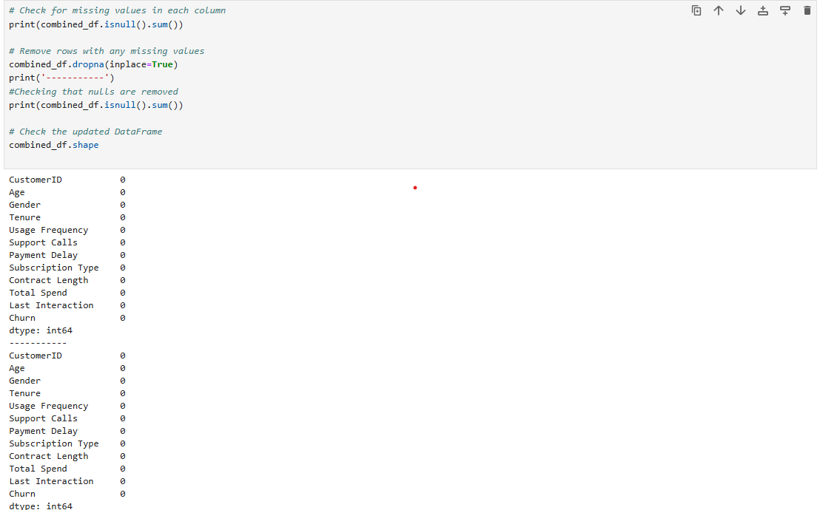

Slide 30
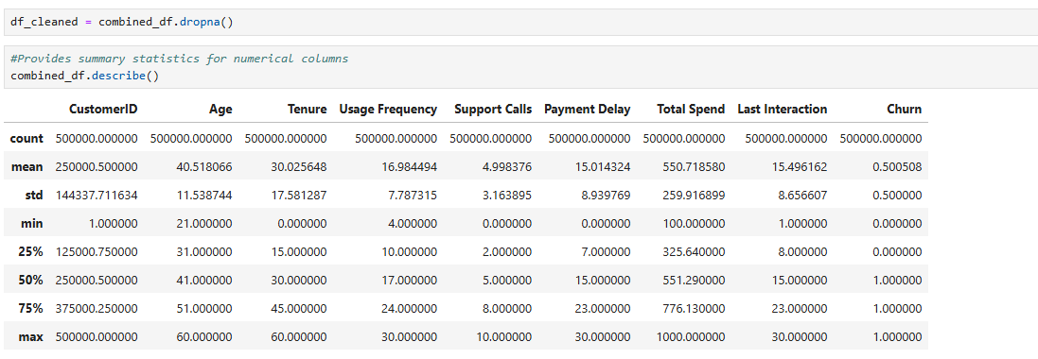

Slide 31
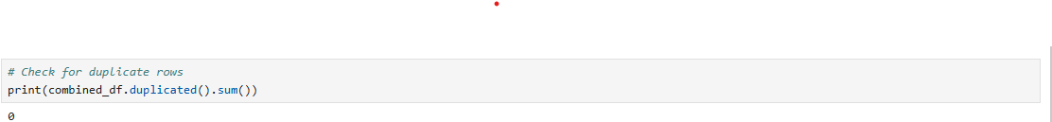

Slide 32
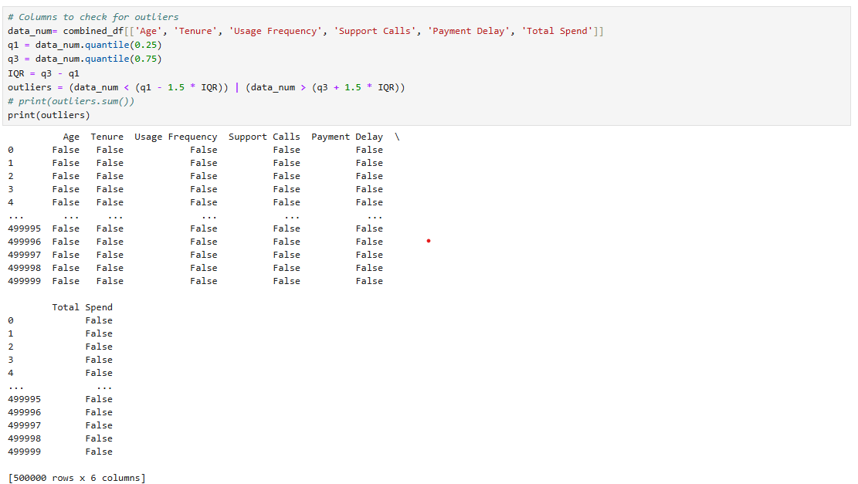

Slide 33
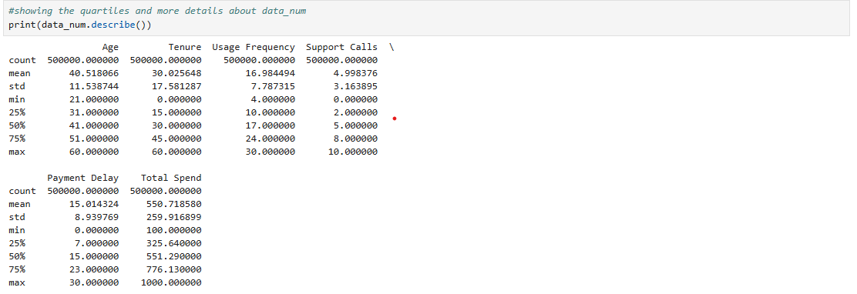

Slide 34
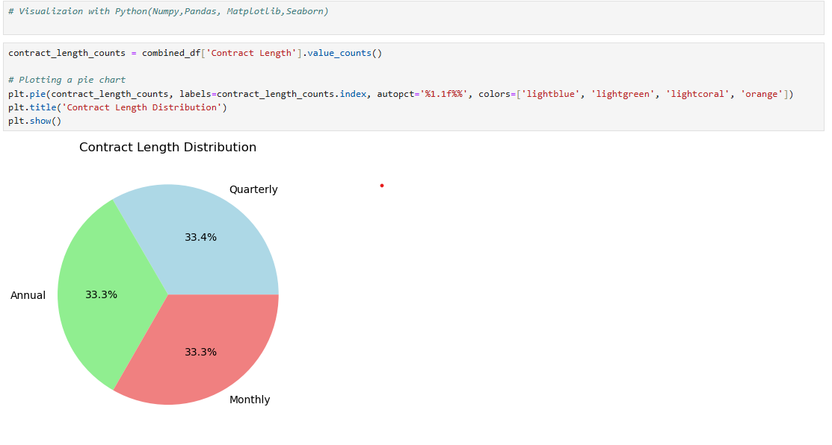

Slide 35
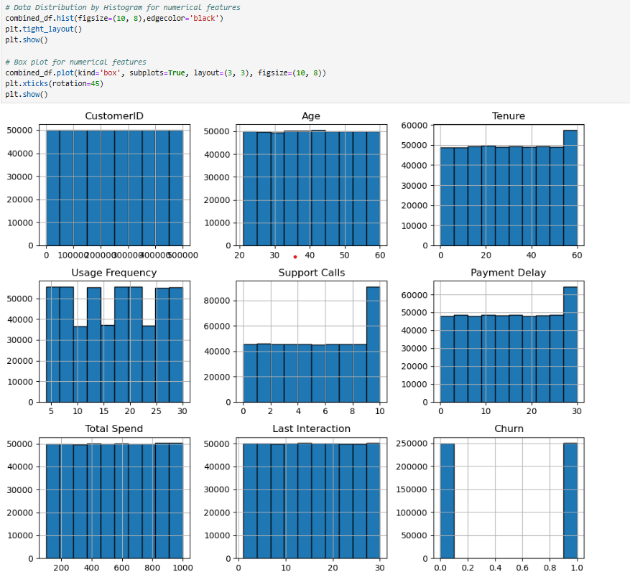

Slide 36
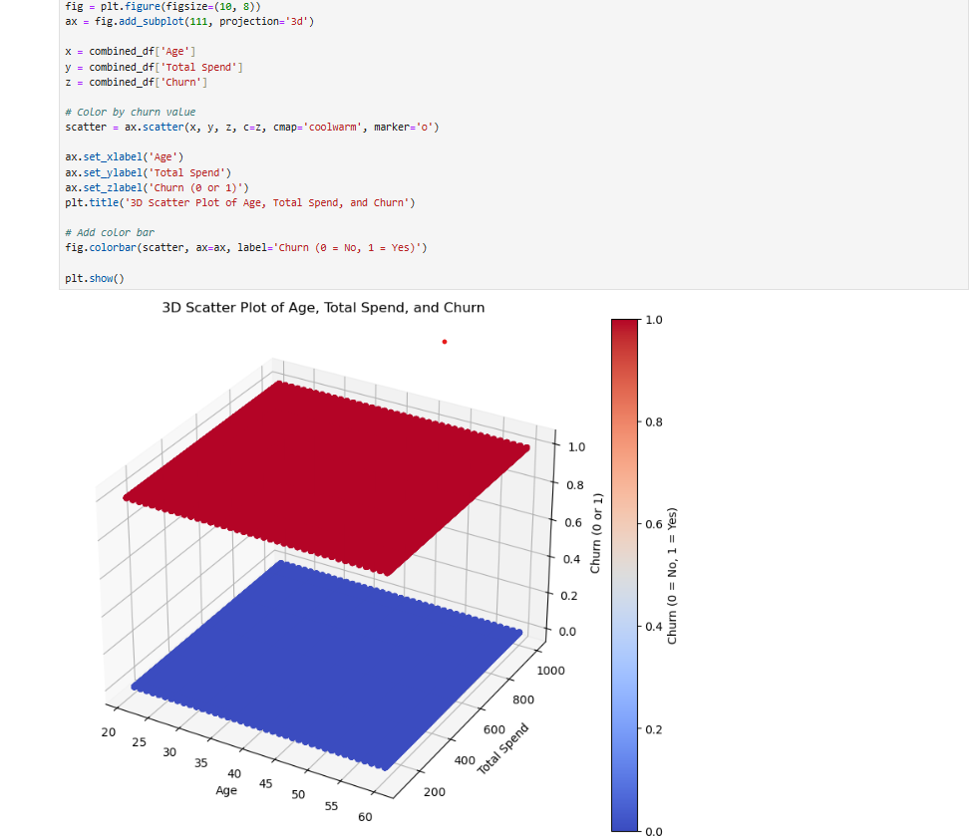

Slide 37
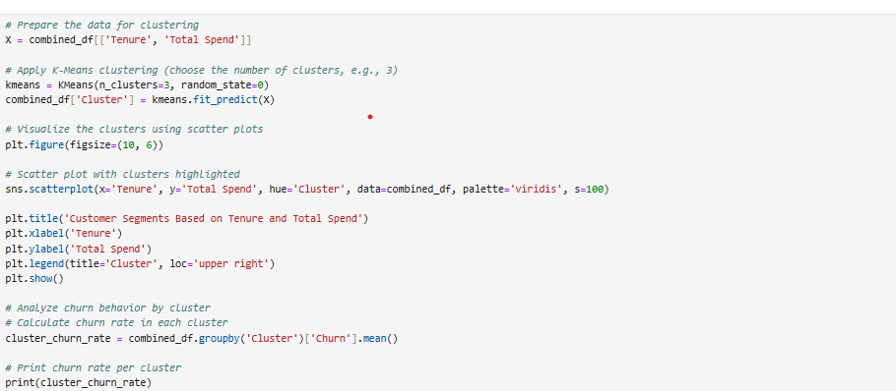

Slide 38
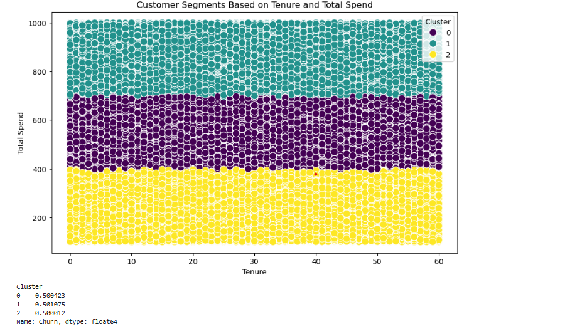

Slide 39
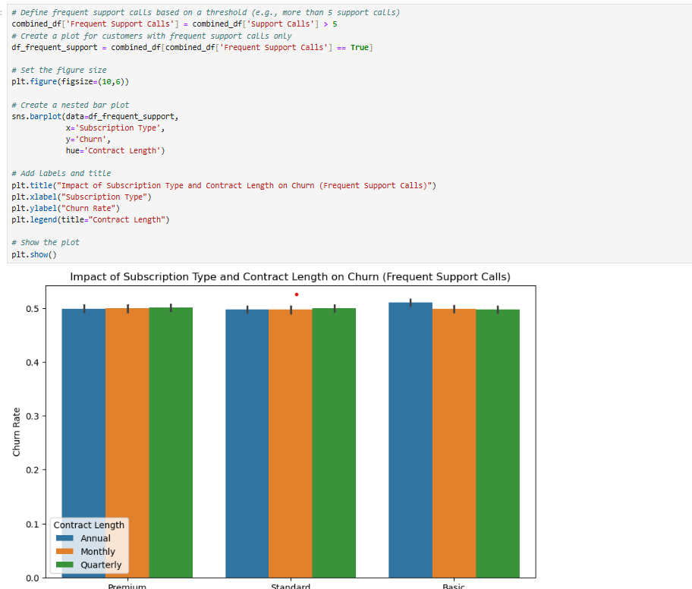

Slide 42
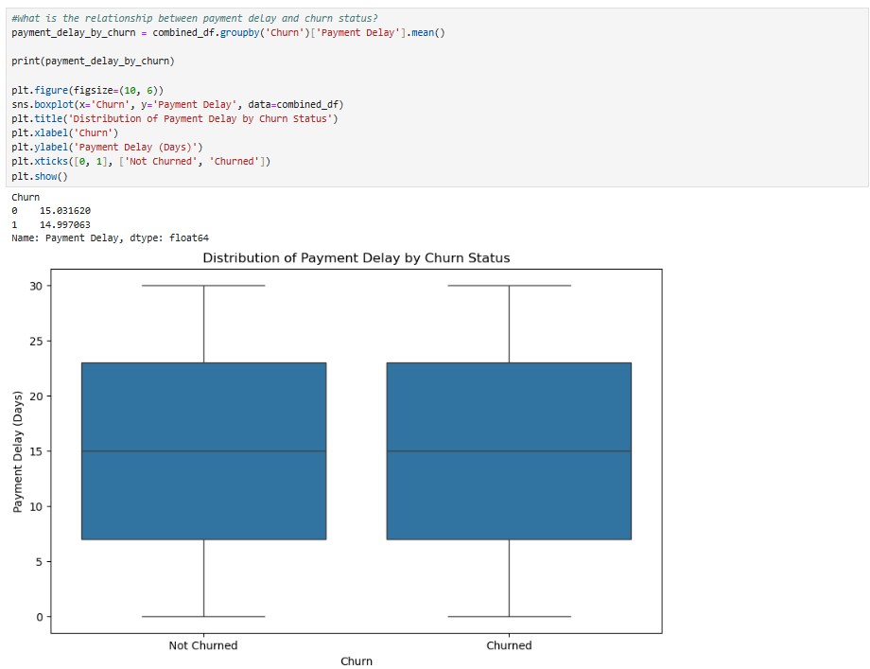

Slide 43
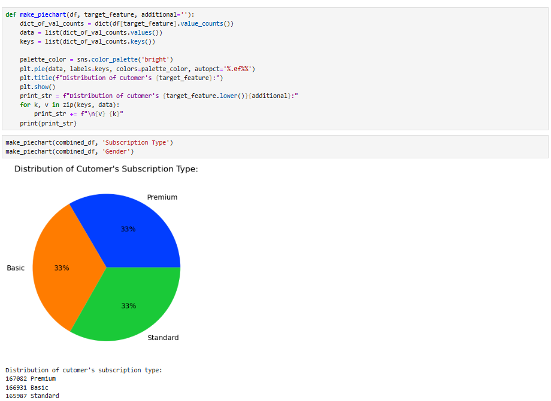

Slide 44
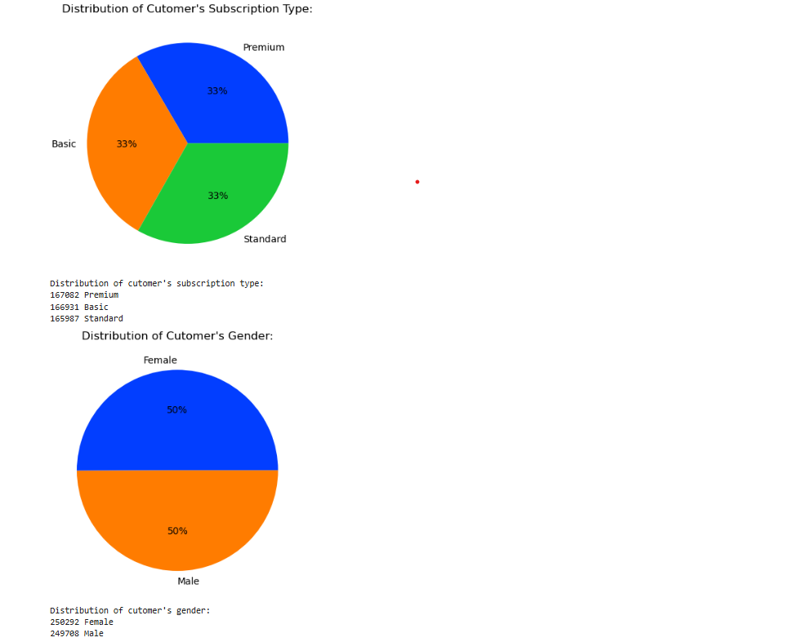

Slide 45
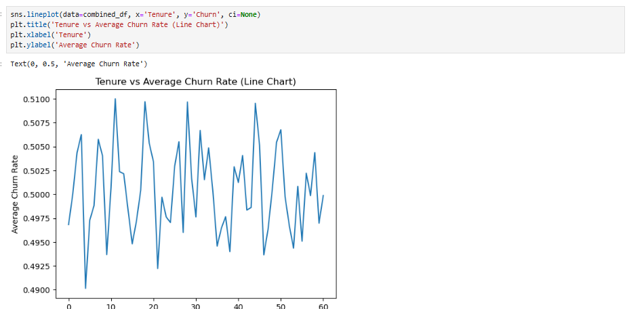

Slide 46
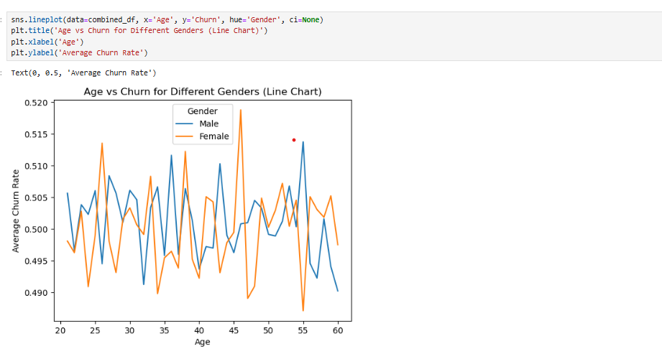

Slide 47
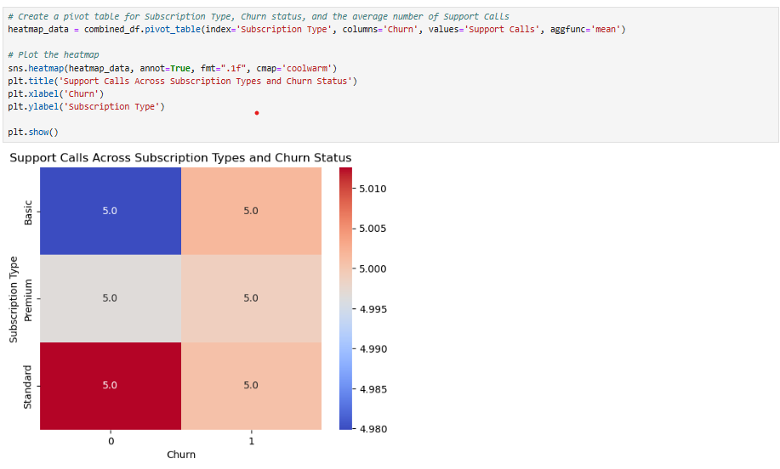

Slide 48
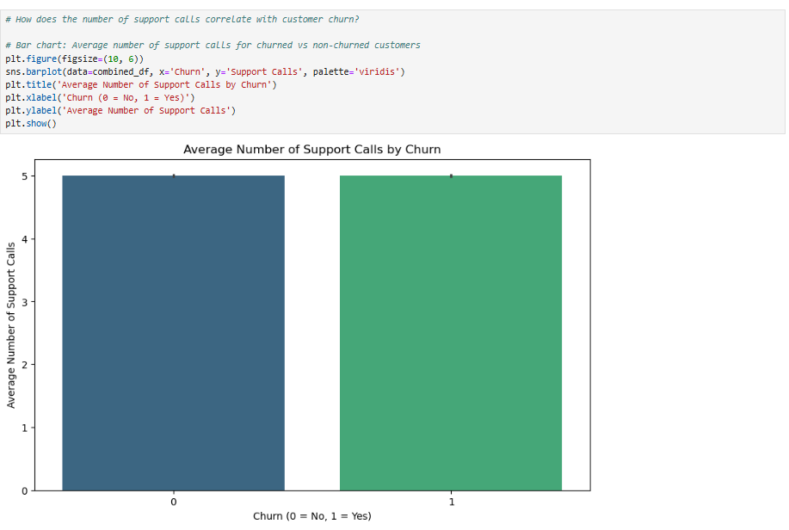

Slide 49
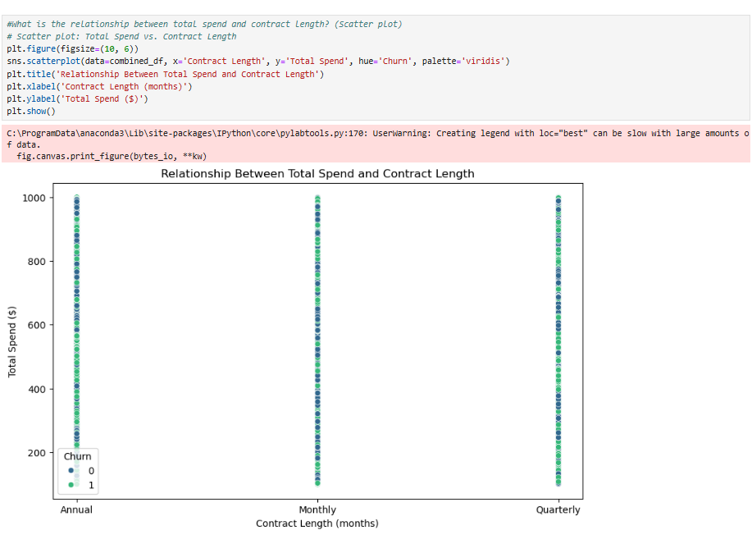

Slide 50
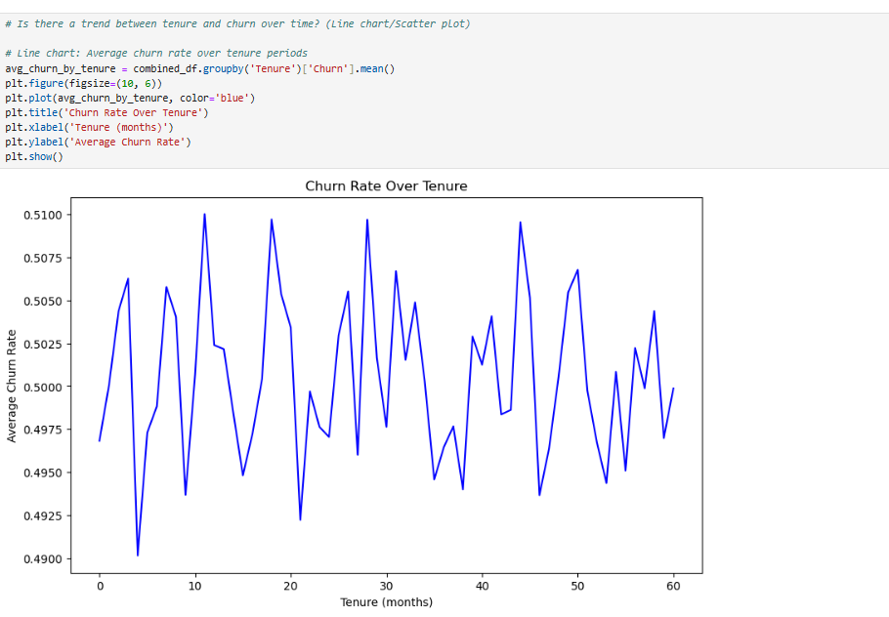

Slide 51
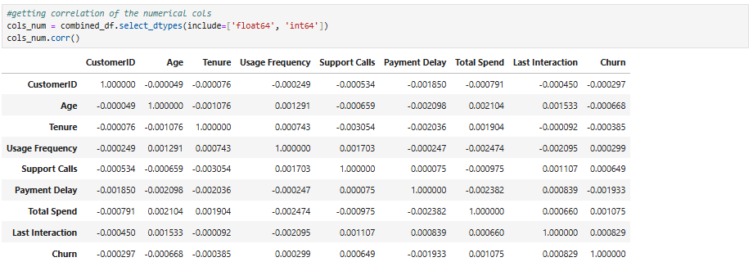

Slide 52
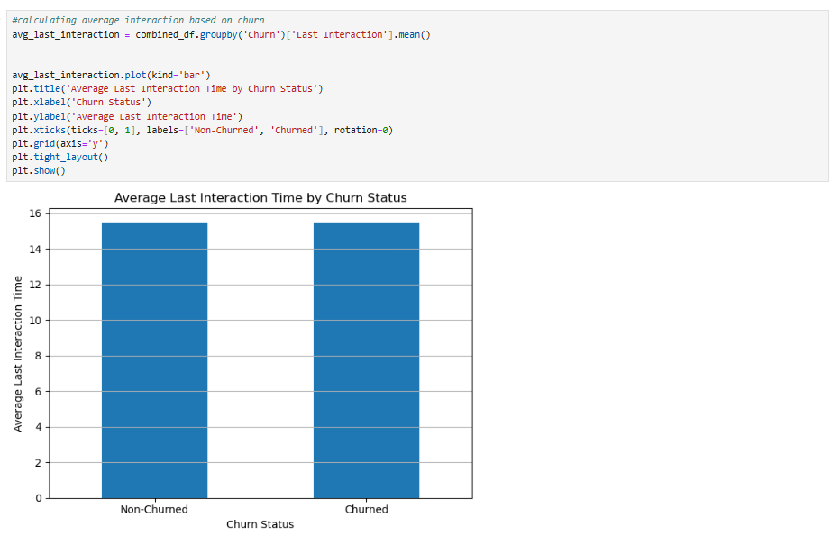

Slide 53
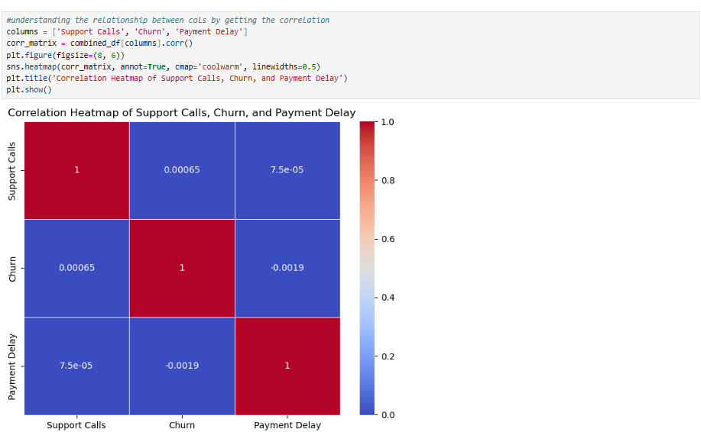

Slide 55
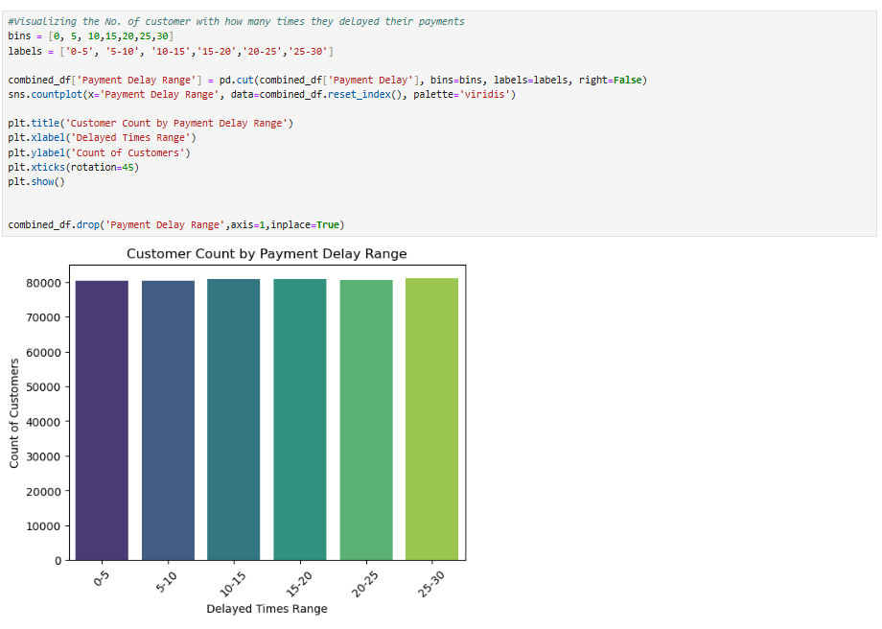

Slide 56
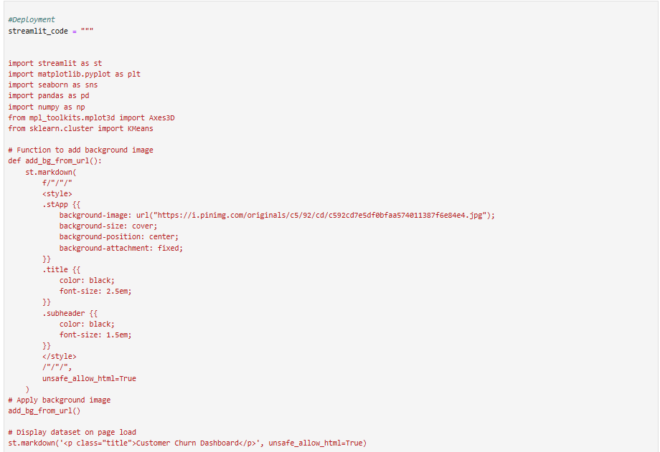

Slide 57
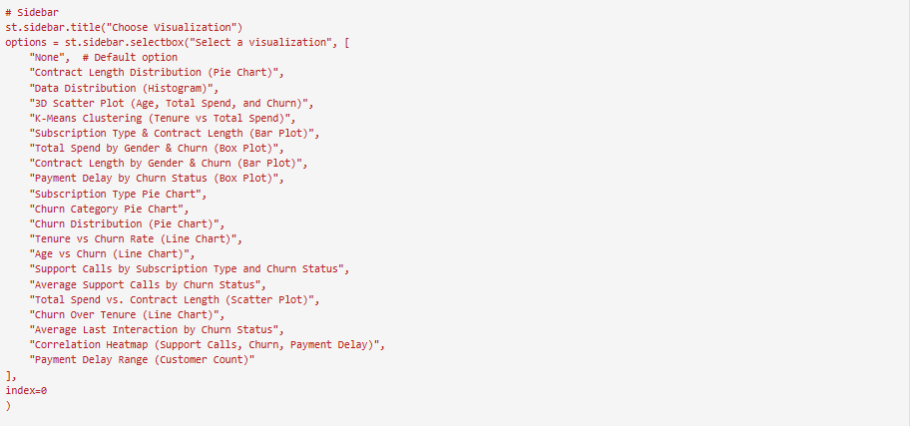

Slide 58
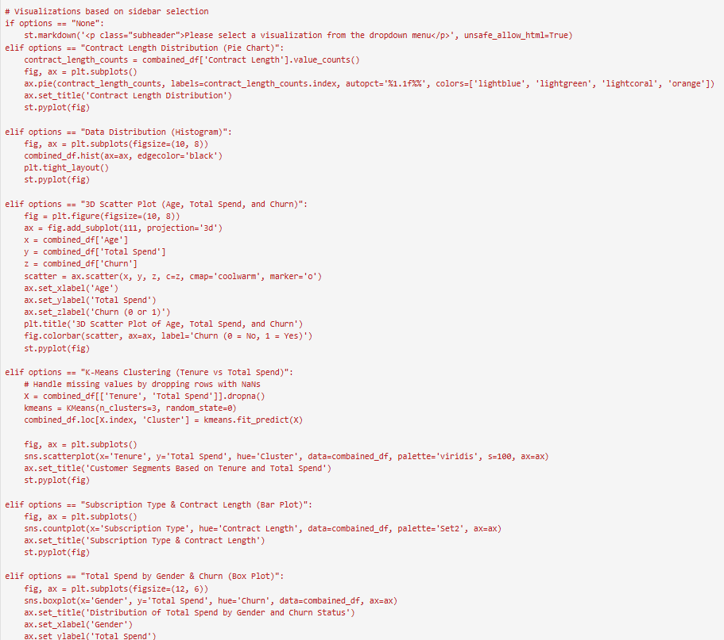

Slide 59
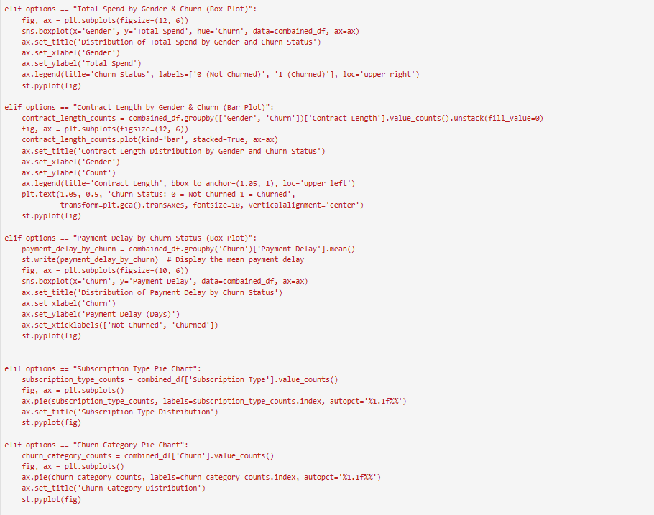

Slide 60
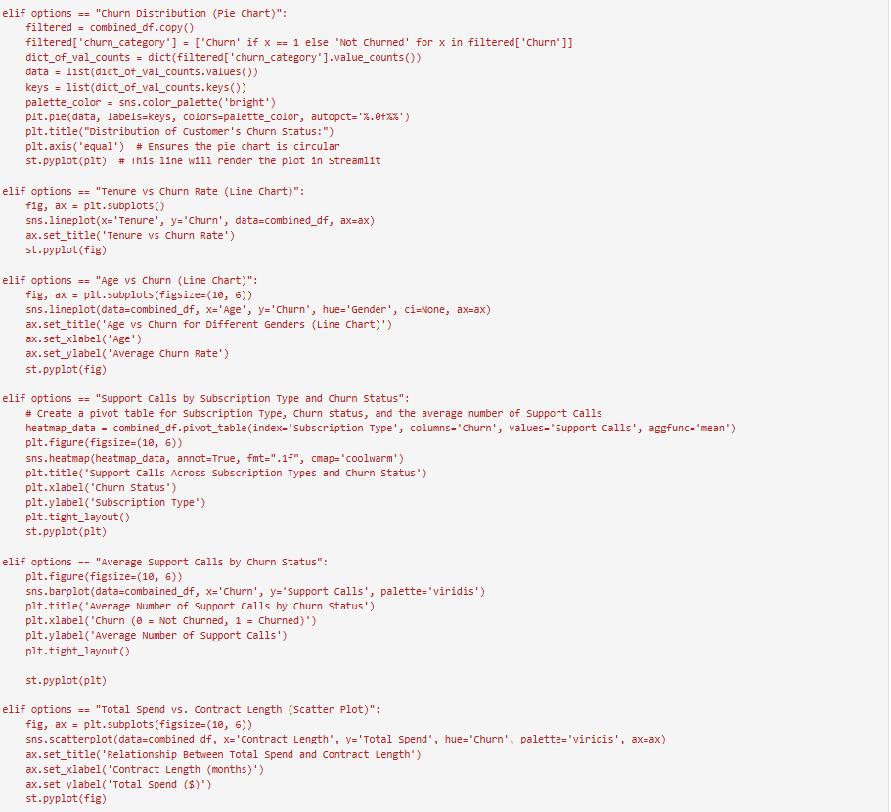

Slide 61
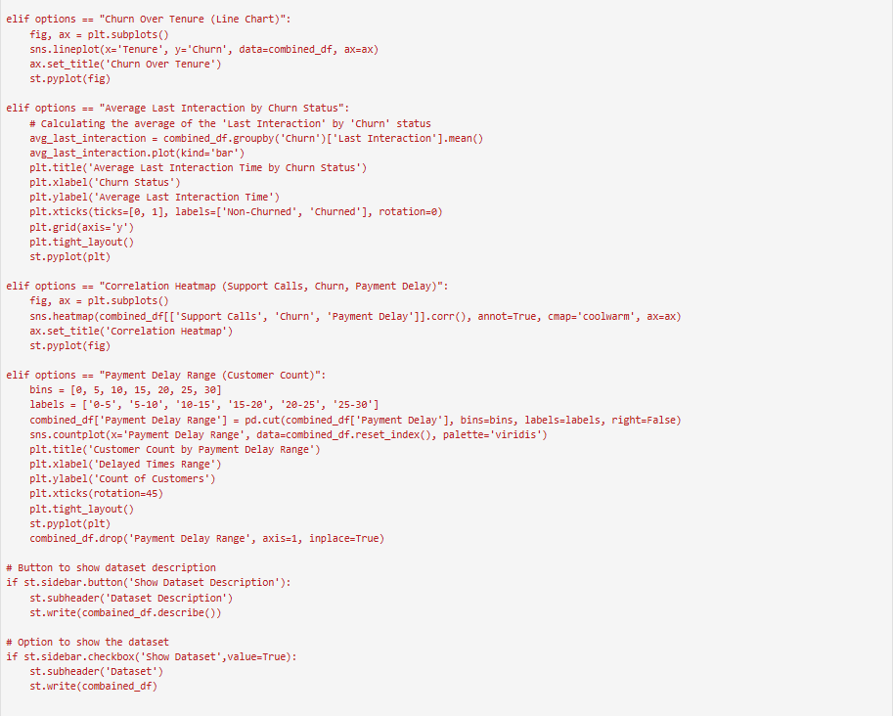

Slide 62
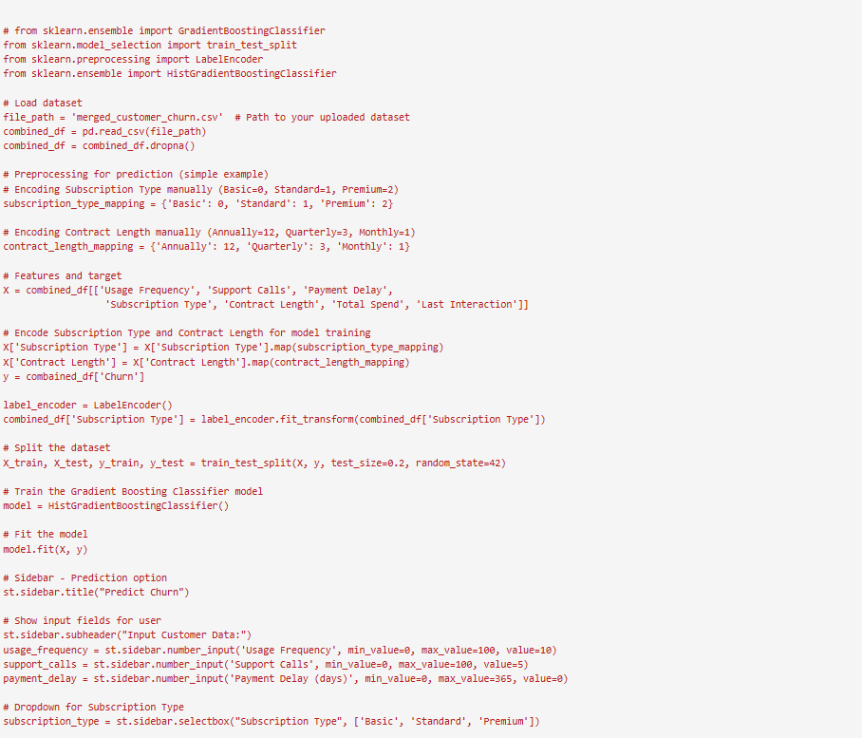

Slide 63
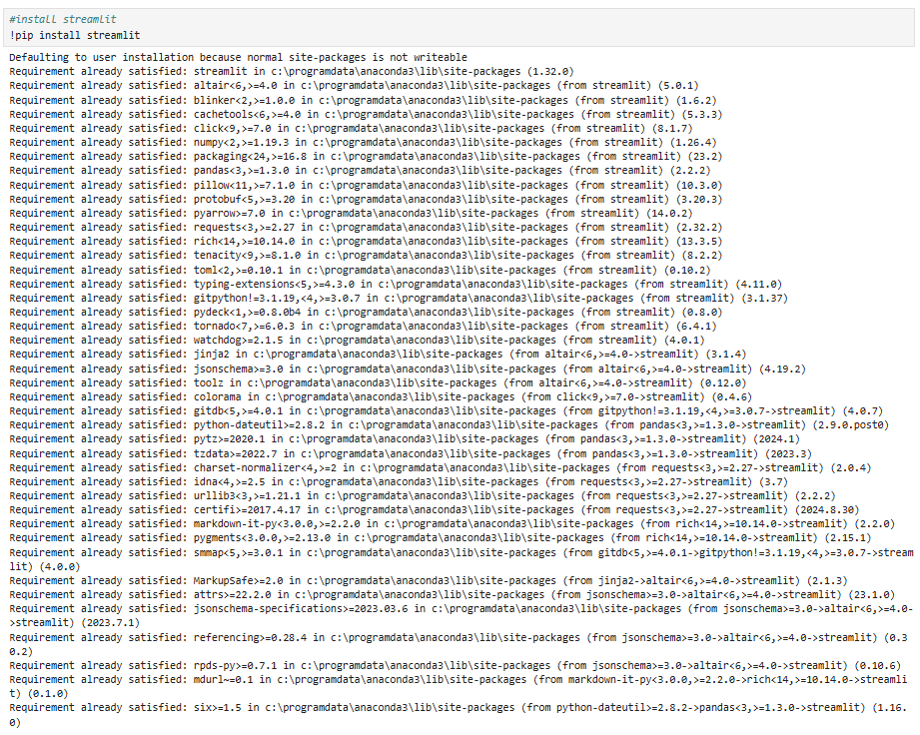

Slide 64
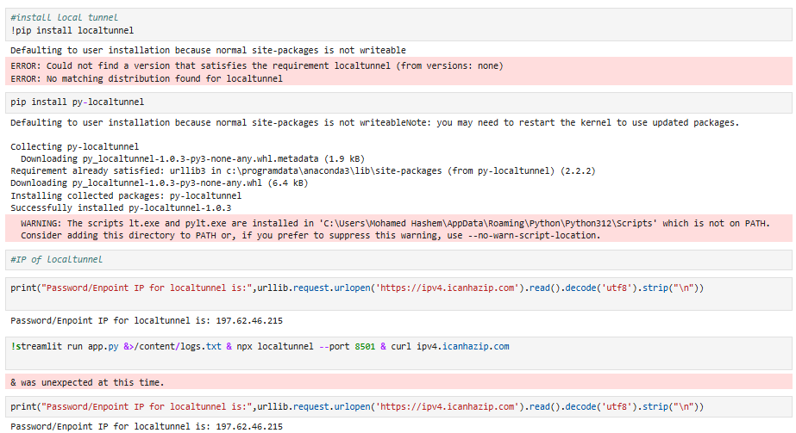

Slide 65
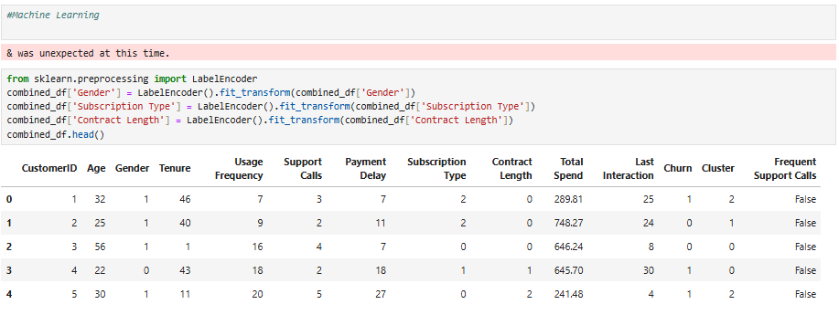

Slide 66
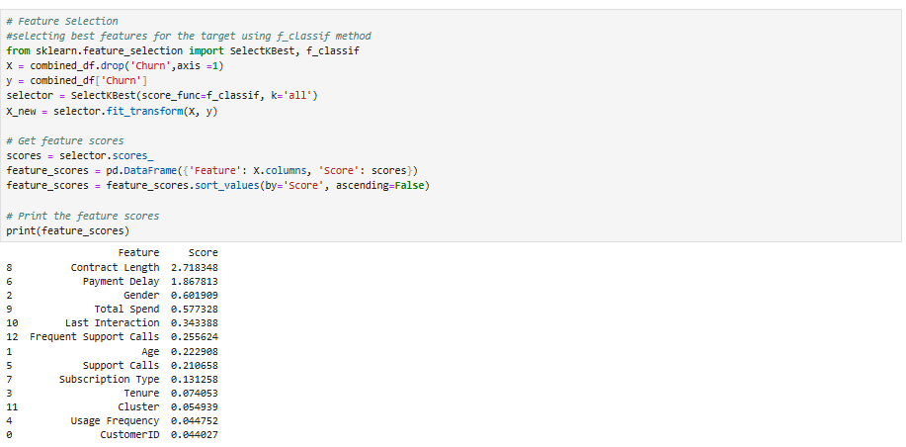

Slide 67
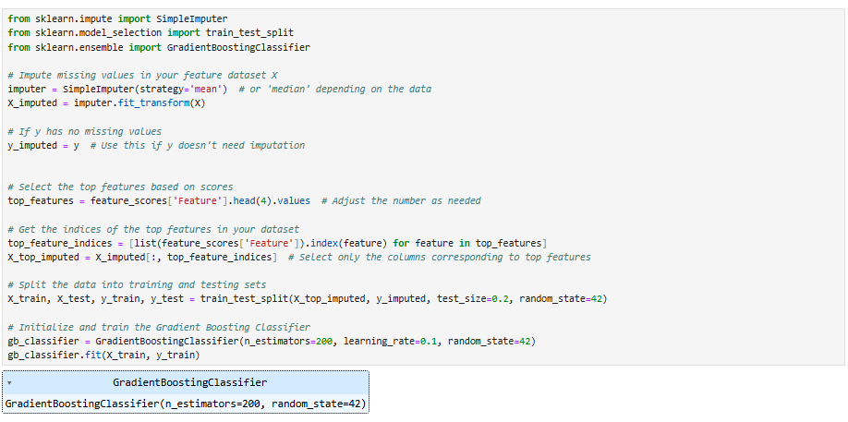

Slide 68
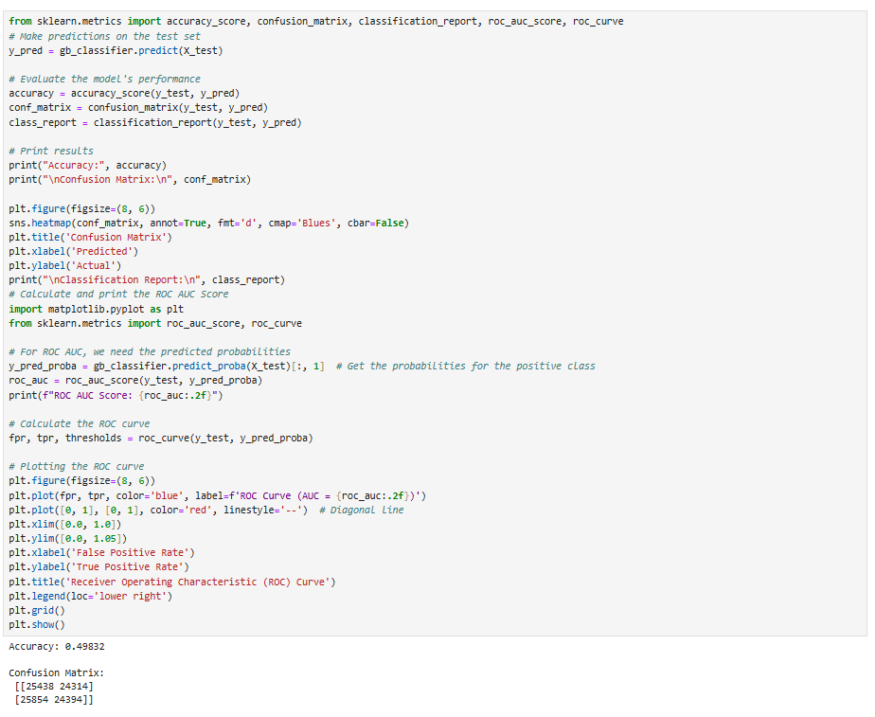

Slide 69
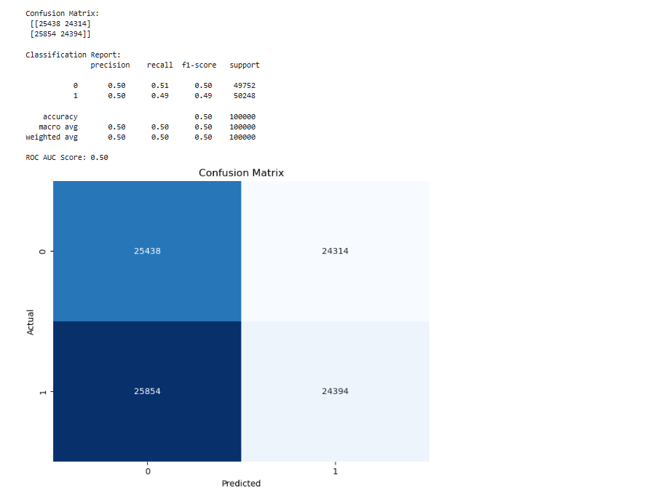

Slide 70
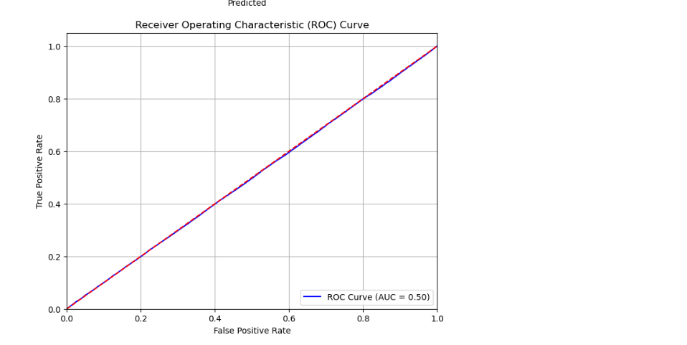

Slide 71
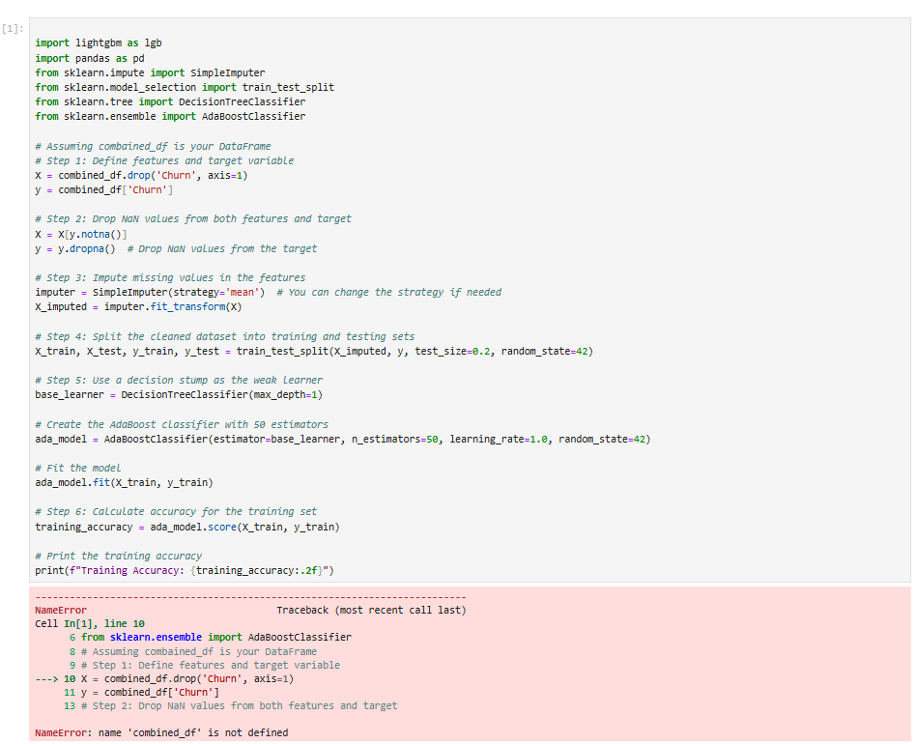

Slide 72
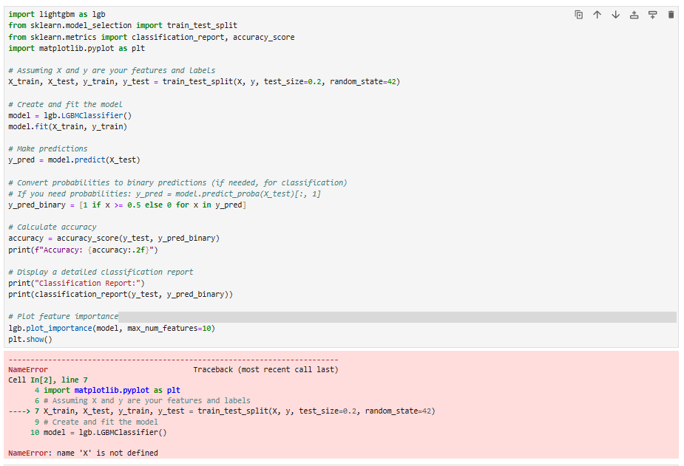

Slide 73


Slide 77
Mlflow
Experiment tracking: Capturing hyperparameters, performance metrics, and other key details to ensure reproducibility and comparison across experiments.
Model logging and registration: Storing the final model version and registering it for
seamless access and future deployment.
This ensures the model is versioned, monitored, and continuously improved as new data becomes available, facilitating efficient updates and maintaining optimal performance over
time.

Slide 78
Mlflow
Experiment tracking: Capturing hyperparameters, performance metrics, and other key details to ensure reproducibility and comparison across experiments.
Model logging and registration: Storing the final model version and registering it for
seamless access and future deployment.
This ensures the model is versioned, monitored, and continuously improved as new data becomes available, facilitating efficient updates and maintaining optimal performance over
time.

Slide 79
Mlflow
Experiment tracking: Capturing hyperparameters, performance metrics, and other key details to ensure reproducibility and comparison across experiments.
Model logging and registration: Storing the final model version and registering it for
seamless access and future deployment.
This ensures the model is versioned, monitored, and continuously improved as new data becomes available, facilitating efficient updates and maintaining optimal performance over
time.

Slide 80
Mlflow
Experiment tracking: Capturing hyperparameters, performance metrics, and other key details to ensure reproducibility and comparison across experiments.
Model logging and registration: Storing the final model version and registering it for
seamless access and future deployment.
This ensures the model is versioned, monitored, and continuously improved as new data becomes available, facilitating efficient updates and maintaining optimal performance over
time.

Slide 81
Mlflow
Experiment tracking: Capturing hyperparameters, performance metrics, and other key details to ensure reproducibility and comparison across experiments.
Model logging and registration: Storing the final model version and registering it for
seamless access and future deployment.
This ensures the model is versioned, monitored, and continuously improved as new data becomes available, facilitating efficient updates and maintaining optimal performance over
time.

Slide 82
Mlflow
Experiment tracking: Capturing hyperparameters, performance metrics, and other key details to ensure reproducibility and comparison across experiments.
Model logging and registration: Storing the final model version and registering it for
seamless access and future deployment.
This ensures the model is versioned, monitored, and continuously improved as new data becomes available, facilitating efficient updates and maintaining optimal performance over
time.

Slide 83
Mlflow
Experiment tracking: Capturing hyperparameters, performance metrics, and other key details to ensure reproducibility and comparison across experiments.
Model logging and registration: Storing the final model version and registering it for
seamless access and future deployment.
This ensures the model is versioned, monitored, and continuously improved as new data becomes available, facilitating efficient updates and maintaining optimal performance over
time.

Slide 84

Thanks!
Do you have any questions?
CREDITS: This presentation template was created by ^{S}S^{lid}li^{e}d^{sg}eº sgo, and includes icons by ^{F}F^{la}l^{t}a^{ico}t^{n}icon, and infographics & images by ^{F}F^{re}r^{e}e^{pik}epik

